Slide 1
Canny edge detector

Slide 2
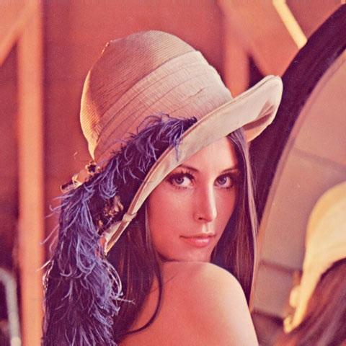

Grayscale conversion

Slide 3




Canny Edge Operator
Smooth image I with 2D Gaussian:
Find local edge normal directions for each pixel
Compute edge magnitudes
Locate edges by finding zero-crossings along the edge normal directions (non-maximum suppression)
$$G∗I$$
$$\bar{n}=\frac{∇\left(G∗I\right)}{\left|∇\left(G∗I\right)\right|}$$
$$\left|∇\left(G∗I\right)\right|$$
$$\frac{∂^{2}\left(G∗I\right)}{∂{\bar{n}}^{2}}=0$$
Notes:
3

Slide 4

Apply Gaussian blur

Slide 5
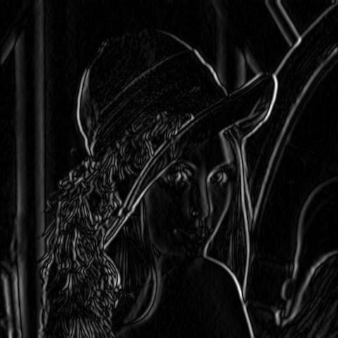
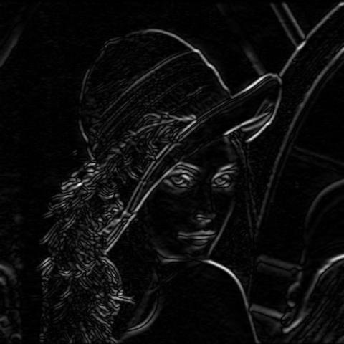
Determine the gradients
Sobel filter
Gx
Gy

Slide 6
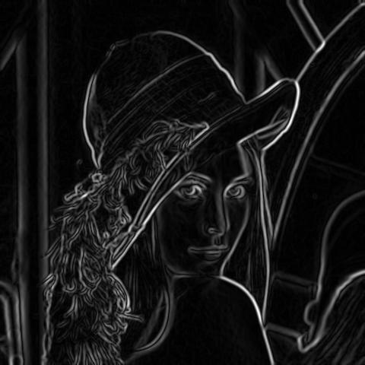
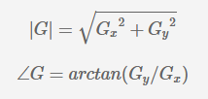
Determine the gradients
calculate the magnitude and angle of the directional gradients
Gradient Magnitude

Slide 7
Determine the gradients
Sobel filter
Gx
Gy
Gradient Magnitude

Slide 8

Non-maximum suppression
Check if pixel is local maximum along gradient direction
requires checking interpolated pixels p and r

Slide 9
Thinning of edges using non-maximal suppression
Non maximum suppression works by finding the pixel with the maximum value in an edge.
It occurs when pixel q has an intensity that is larger than both p and r where pixels p and r are the pixels in the gradient direction of q.
If this condition is true, then we keep the pixel, otherwise we set the pixel to zero (make it a black pixel).

Slide 10
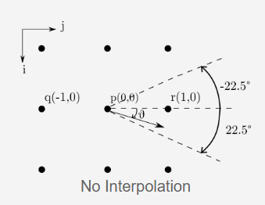
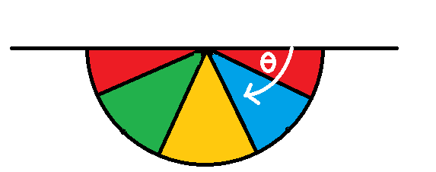
Thinning of edges using non-maximal suppression
When looking at a pixel there are only four directions when checking the surrounding pixels in a reverse trigonometric direction:
0 degrees => horizontal direction
45 degrees => positive diagonal
90 degrees => vertical direction
135 degrees => negative diagonal
Non Maximum Suppression with Interpolation

Slide 11
Thinning of edges using non-maximal suppression
The red area covers the intervals [0, 22.5) and [157.5, 180] => we are looking at pixel (x, y-1) and pixel (x, y+1)
The blue area lies between [22.5 , 67.5) => we are looking at pixel (x-1, y-1) and pixel (x+1, y+1)
The yellow area lies between [67.5, 112.5) => we are looking at pixel (x-1, y) and pixel (x+1, y)
The green area lies between [112.5, 157.5) => we are looking at pixel (x+1, y-1) and pixel (x-1, y+1)
If the current pixel is greater than both of his neighbors then we keep it. As a result, the algorithm gets thinner edges.

Slide 12
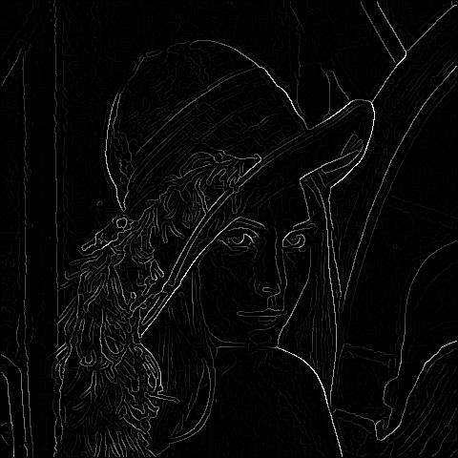
Thinning of edges using non-maximal suppression
Non Maximum Suppression with Interpolation

Slide 13
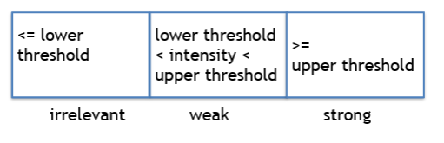
Double thresholding

Slide 14
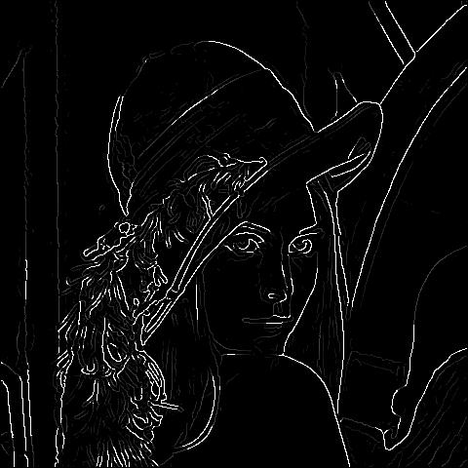
Double thresholding
Non Maximum Suppression with Interpolation

Slide 15
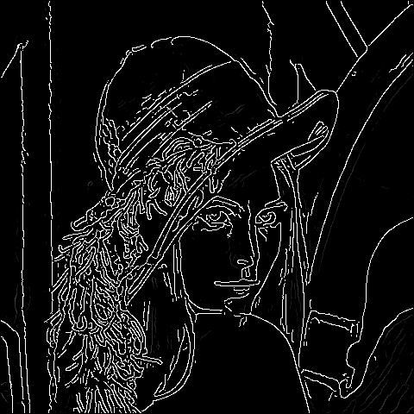
Double thresholding
determine which weak edges are actual edges - edge tracking algorithm
Weak edges that are connected to strong edges will be actual/real edges. Weak edges that are not connected to strong edges will be removed.

Slide 16
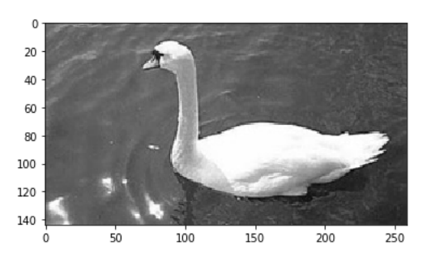
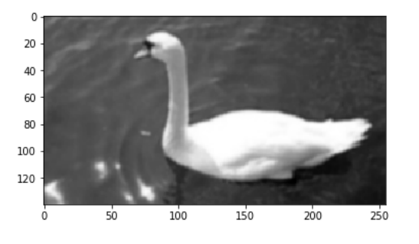
Canny edge detection

Slide 17
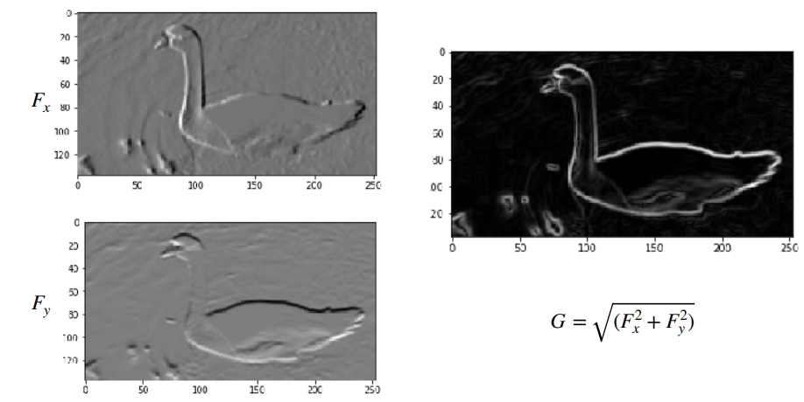
Canny edge detection

Slide 18
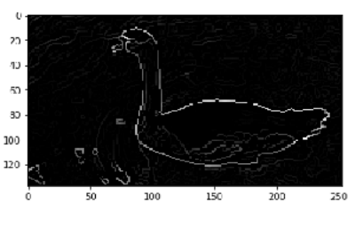
Canny edge detection

Slide 19
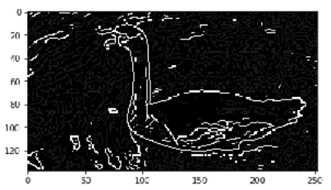
Canny edge detection

Slide 20
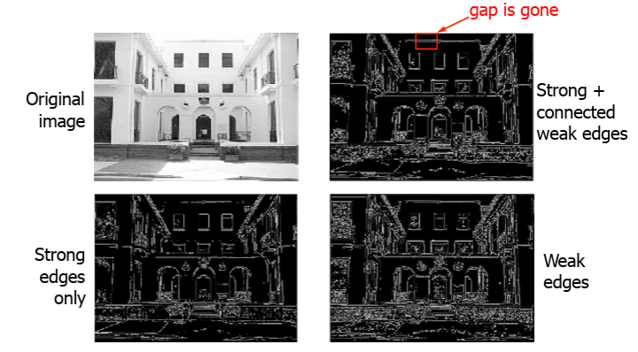
Canny edge detection

Slide 21
Demo
http://shd101wyy.github.io/edge-detection/

